Slide 1
Chapter 6
Constrained Optimization Methods
  Constrained optimization methods are for nonlinear constrained optimization problems, which have the following generalized form:
  min f(X)
  s.t. g_{u}(X) ≤ 0 (u = 1, 2, ···, p)
  h_{v} (X) = 0 (v = 1, 2, ···, m)
  The optimal solution of the constrained problem is not only related with the objective function, but restricted with constraint conditions. Hence the solving method is much more complicated than that of unconstrained optimization problems.

Slide 2
Classification of Constrained Optimization Methods
  The key issue of solving nonlinear constrained problems is to deal with the constraints. The solving methods can be classified into direct methods and indirect methods.
  In direct methods, the iteration points are always confined in the feasible region, after considering all the constraints. e.g., Feasible Direction Method.
  In indirect methods, constraints are put into the objective function such that constrained problems can be converted to unconstrained problem, or nonlinear problems are converted to relatively simple quadratic programming problems. e. g. Penalty Function Method, SQP (Sequential Quadratic Programming) Method.

Slide 3
Effective Constraints
  The constraint conditions can be divided as effective constraints and ineffective constraints, depending on whether the investigated point is on the constraint boundary or not.
  The number of effective constraints of the investigated point X_{k} and the corresponding sequence number can be presented in terms of set and expressed as:
  I_{k} = {u | g_{u} (X_{k}) = 0 (u = 1, 2, ···, p)}
  where, I_{k} represents the subscript set of the effective constraints of point X_{k} (as shown below).

Slide 4
Extremum Conditions (ECs) for Constrained Problems
  There are various cases for the extremum values of constrained problems.
  1.When the minimum point of the objective function is located inside the feasible region, it is the minimum point of the constrained problem;
  2.When the minimum point is outside the feasible region, the minimum point of the constrained problem is located on the constraint boundary - it is the tangential point of the boundary and one of the contours of the objective function.

Slide 5
ECs for Constrained Problems (II)
  1) ECs for equality-constrained problems:
  For optimization problems with equality constraints:
  min f(X)
  s.t. h_{v} (X) = 0 (v = 1, 2, ···, m)
  The Lagrange function can be established as follows:
  L (X, λ) = f(X) + ∑λ_{v} h_{v}(X)
  where, λ = [λ₁, λ₂, ···, λ_{m}]^{T} is the Lagrangian multiplier vector.

Slide 6
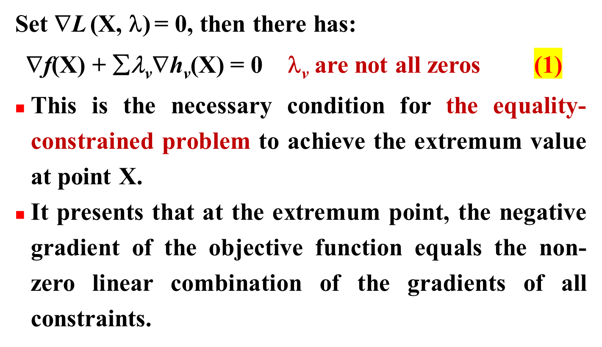
ECs for Constrained Problems (III)

Slide 7
ECs for Constrained Problems (IV)
  2) ECs for inequality-constrained problems:
  min f(X)
  s.t. g_{u} (X) ≤ 0 (u = 1, 2, ···, p)
  By introducing p slack variables x_{n+u} ≥ 0 (u = 1, 2, ···, p), the following inequality-constrained problem becomes a inequality-constrained problem:
  min f(X)
  s.t. g_{u} (X) + x_{n+u}² = 0 (u = 1, 2, ···, p)
  Establish the Lagrange Function for the new problem:
  L (X, λ, X) = f(X) + ∑λ_{u}[g_{u} (X)+ x_{n+u}²]
  where,X =[x_{n+1} , x_{n+2} , ···, x_{n+p}]^{T} is a vector comprised by the slack variables.

Slide 8
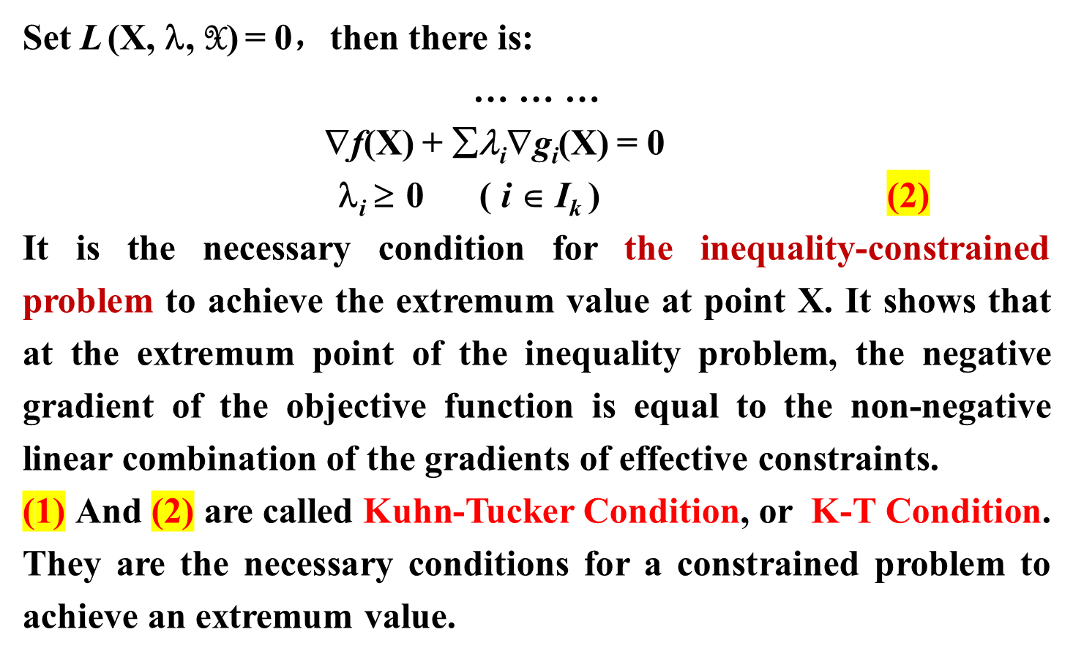
ECs for Constrained Problems (V)

Slide 9
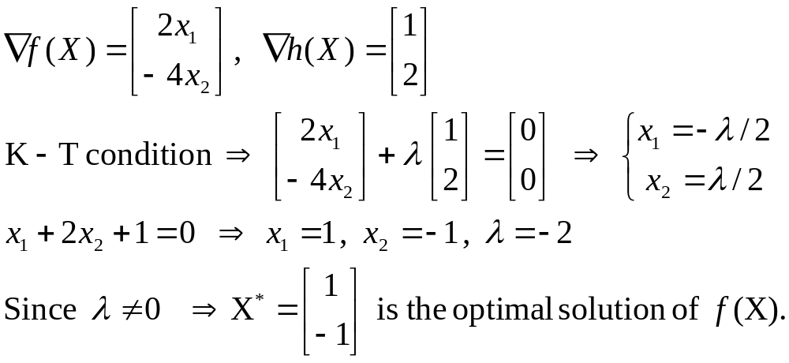
Example 1
Solve the optimization problem with equality constraints:
min f(X) = x₁² − 2x₂²
s.t. x₁ + 2x₂ + 1 = 0
Solution:

Slide 10
Example 2
Identify whether X_{k} = [2, 0]^{T} is the minimum point of the optimization problem or not:
min f(X) = (x₁ − 3)² + x₂²
s.t. x₁² + x₂ − 4 ≤ 0
− x₂ ≤ 0
− x₁ ≤ 0
Solution:
g₁(X_{k}) = 0 g₂(X_{k}) = 0 g₃(X_{k}) = -2 ≠ 0
Thus the effective constraints are g₁(X) and g₂(X).

Slide 11
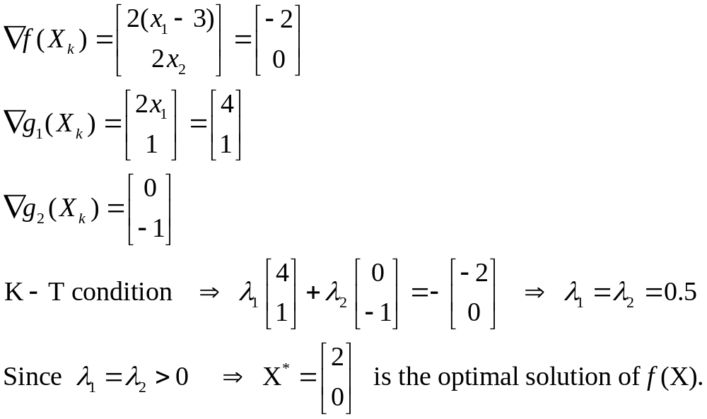
Example 2 (Cont’d)

Slide 12
6.1 Feasible Direction Method
  Feasible Direction Method is a direct method for solving inequality-constrained problems, which are generally formulated as:
  min f(X)
  s.t. g_{u} (X) ≤ 0 (u = 1, 2, ···, p)
  The basic idea of this method can be described as: Starting from a feasible point inside the feasible region, choose a suitable search direction S_{k} and step length α_{k} such that the next iteration point:
  X_{k+1} = X_{k} + α_{k}S_{k}
  is still inside the feasible region while make the objective function value decrease mostly.

Slide 13
6.1 Feasible Direction Method (II)
  Thus, the new iteration point satisfies:
  g_{u}(X) ≤ 0 (u = 1, 2, ···, p) (1)
  and f(X_{k+1}) - f(X_{k}) ≤ 0 (2)
  The direction satisfying (1) is called Feasible Direction, while the one satisfying (2) is Descent Direction. If the direction satisfies both (1) and (2), then it is called Descent Feasible Direction.
  It can be inferred that start from any point inside the feasible region, the optimal point of the constrained problem can be approached via linear search along the descent feasible direction while the constraints are considered.

Slide 14
6.1.1 Descent Feasible Direction
  Descent Direction:
  As we know, the direction having an obtuse angel with the gradient make the function value decrease. That is, the descent direction S at point X_{k} satisfies:
  [∇f(X_{k})]^{T}S < 0
  Feasible Direction: the direction pointing inward to the feasible region.
  (1) When X_{k} is inside the feasible region, any direction starting from X_{k} is a feasible direction (Fig. 6-1a).

Slide 15
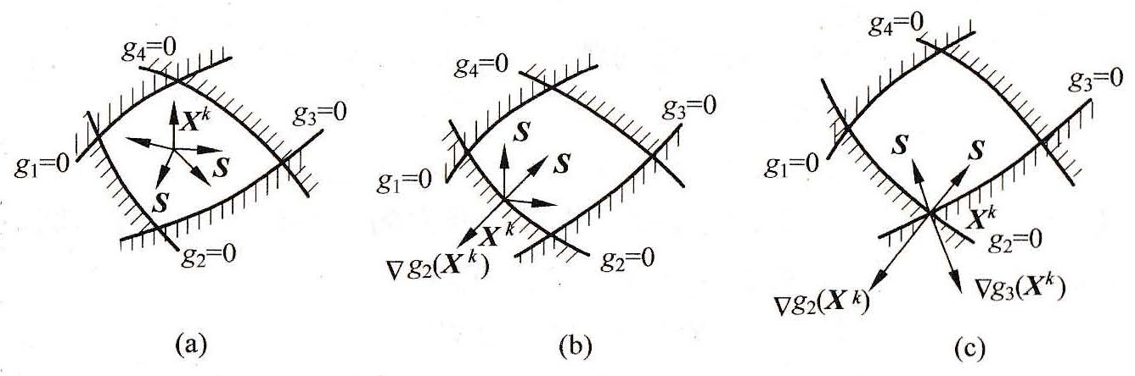
6.1.1 Descent Feasible Direction
  (2) When X_{k} is on the boundary of one effective constraint g_{i} (X) = 0, direction S starting from X_{k} has to satisfy:
  [∇g_{i} (X_{k})]^{T}S < 0 ( i ∈ I_{k} )
  (as shown in Fig. 6-1b)
  Fig. 6-1

Slide 16
6.1.1 Descent Feasible Direction (II)
  (3) When X_{k} is located on the intersection of several boundaries of effective constraints g_{i} (X) = 0 (i∈I_{k}), the feasible direction S must have obtuse angels with gradients of each effective constraint (Fig. 6-1c).
  From above discussion, a descent feasible direction S, which not only decreases the function value but points inward the feasible region, must satisfy:
  [∇f(X_{k})]^{T}S <0 (6-3a)
  [∇g_{i} (X_{k})]^{T}S < 0 ( i ∈ I_{k} ) (6-3b)
  where I_{k} is the subscript set of the effective constraints.

Slide 17
6.1.2 Optimal Desc. Feas. Direction
  Among all the descent feasible directions of X_{k}, the one makes the function value decrease most is called Optimal Descent Feasible Direction (ODFD).
  When X_{k} is in the feasible region, the negative gradient at this point is the ODFD; when X_{k} is on the crossing line of several boundaries of effective constraints, (6-3) provides the existence range of all the descent feasible directions.

Slide 18
6.1.2 ODFD (II)
  ODFD can be obtained via minimizing the directional derivative of the objective function, on the premise of satisfying feasible conditions.
  Thus, the problem of seeking the optimal descent feasible direction S can be described as follows:
  min [∇f (X_{k})]^{T}S
  s.t. [∇g_{i} (X_{k})]^{T}S < 0 ( i ∈ I_{k} )
  in which S =[s₁, s₂, ···, s_{n}]^{T}
  -1 ≤ s_{j} ≤ 1 ( j = 1, 2, ···, n)

Slide 19
6.1.2 ODFD (III)
  Since ∇f(X_{k}) and ∇g_{i}(X_{k}) ( i∈I_{k} ) are known vectors, both the objective function and the constraint functions are linear functions of variables s₁, s₂, ···, s_{n} . Thus this problem turns out to be a typical linear optimization problem. Hence the optimal descent direction S* can be obtained by using the Simplex Method.
  Let S* be the search direction, i.e., S_{k} = S* , then a 1-D search can be conducted along this search direction to acquire the optimal solution of this nonlinear optimization problem, considering the constraints.
  This method is called “Feasible Direction Method” and This 1-D search is called “Constrained 1-D Search”.

Slide 20
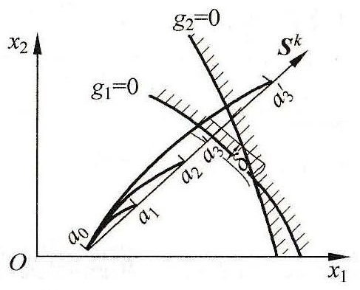
6.1.3 Constrained 1-D Search
  Different from unconstrained 1-D search, the feasibility of every iteration point generated by the constrained 1-D search should be checked. If one or some constraint conditions are violated, then the step length ought to be reduced to make sure the new search point locate on the closest constraint boundary or within an allowed range of the constraint boundary. (as illustrated)

Slide 21
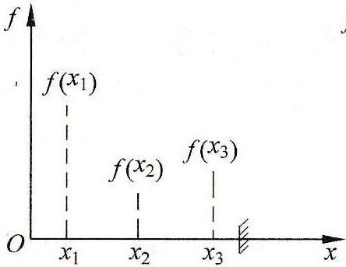
6.1.3 Constrained 1-D Search
  If three adjacent search points are all feasible pints and a convex shape can be formed by these three points, the initial search interval can be determined. This initial search interval is then gradually shortened to acquire the minimum point of this constrained optimization problem. (as shown)

Slide 22
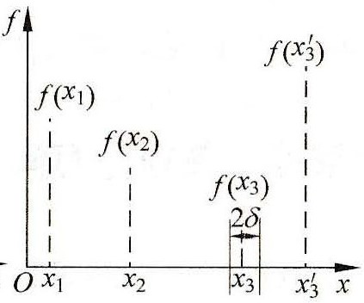
6.1.3 Constrained 1-D Search
  If the obtained search point is located within the allowance (±δ) of the constraint boundary, and the function value of this search point is smaller than that of the previous search point (as shown below), then this obtained point is the minimum point of this constrained optimization problem.

Slide 23
6.1.4 Algorithm of FDM
  1) The initial inner point X₀, convergence accuracy ε and the constraint allowance δ are provided. Set k = 0.
  2) Identify the effective constraints of point X_{k} :
  I_{k} (X_{k} , δ) ={u| -δ ≤ g_{u} (X_{k}) ≤ δ (u = 1, 2, ···, p)}
  3) Convergence Judgement:
  When I_{k} is a null set and X_{k} is within the feasible region, if ||∇f(X_{k})|| ≤ ε, then the algorithm can be terminated and X* = X_{k} , f* = f(X_{k}); Otherwise, let S_{k} = -∇f(X_{k}), go to Step 6.
  When I_{k} is a non-null set, go to Step 4.

Slide 24
6.1.4 Algorithm of FDM
  4) Convergence Judgement:
  If X_{k} satisfies the K-T condition:
  ∇f(X_{k}) + ∑ λ_{u}∇g_{u}(X_{k}) = 0 λ_{u} ≥ 0
  Then the algorithm can be terminated and there is X*=X_{k}，f*= f(X_{k})；Otherwise, go to Step 5.
5) Solve the linear optimization problem:
min [∇f(X_{k}) ]^{T}S
s.t. [∇g_{u}(X_{k})]S ≤ 0 (u∈I_{k})
-1 ≤ s_{j} ≤ 1 ( j = 1, 2, ···, n)
Then let S_{k} = S* = the optimal search direction.
6) Along the search direction S_{k}, conduct the 1-D constrained search to acquire X_{k+1}, let k=k+1, go to Step 2.

Slide 25
Example 6-1
Solve the following nonlinear constrained problem using the FDM：
min f(X) = x₁² + x₂² - x₁x₂ - 2x₁ - 3x₂
s.t. g₁(X) = x₁ + x₂ - 2 ≤ 0
g₂(X) = x₁ + 5x₂ - 5 ≤ 0
g₃(X) = -x₁ ≤ 0
g₄(X) = -x₂ ≤ 0

Slide 26
Solution to Example 6-1
(1) Choose X₀ = [0, 0]^{T} , then:
f(X₀) = 0 , ∇f(X₀) = [-2, -3]^{T} , I_{k} = {3, 4}
∇g₃(X) = [-1, 0]^{T} , ∇g₄(X) = [0, -1]^{T}
Convergence judgement: at X₀ = [0, 0]^{T}
λ₁ = -2 and λ₂ = -3, K-T NOT satisfied, continue.
(2) Solve for the optimal direction at X₀:
min ∇f(X₀)^{T}S = -2s₁ – 3s₂
s.t. -s₁ ≤ 0 , -s₂ ≤ 0
-1 ≤ s_{j} ≤ 1 ( j = 1, 2 )
to have S* = [1, 1]^{T} . Then, S₀ = [1, 1]^{T} .

Slide 27
Solution to Ex. 6-1 (Cont’d)
(3) Conduct a 1-D constrained search along the direction S₀ :
X₁ = X₀ + αS₀ = [α, α]^{T} , f(X₁) = α₀² – 5α₀
df(X₁)/dα₀ = 0 ⇒ α₀ = 5/2 ⇒ X₁ = [5/2, 5/2]^{T} .
Note that X₁ is within boundaries of constraints of g₃(X) and g₄(X), but out of those of g₁(X) and g₂(X), so it is NOT the constrained minimum point along S₀ .
Hence X₁ = [α, α]^{T} is put into g₁(X) = 0 and g₂(X) = 0 to solve out α₁ = 1 and α₂ = 5/6 . Thus, X* = [5/6, 5/6]^{T} is the constrained minimum point along the direction S₀.

Slide 28
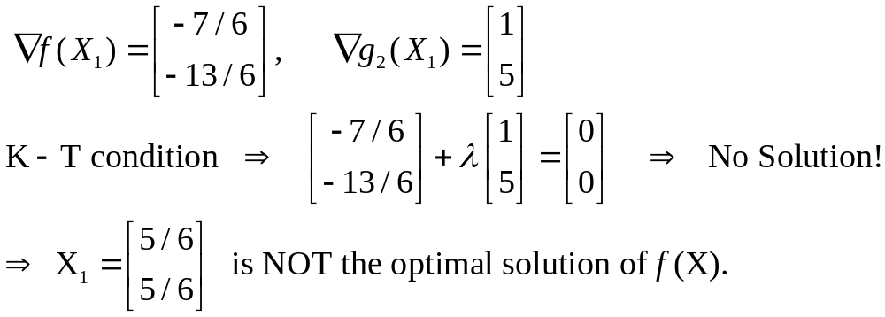
Solution to Ex. 6-1 (Cont’d)
(4) Convergence judgement:
at X₁ = [5/6, 5/6]^{T} :

Slide 29
Solution to Ex. 6-1 (Cont’d)
(5) Solve for the optimal direction at X₁ :
min ∇f(X₁)^{T}S = - (7/6)s₁ – (13/6)s₂
s.t. s₁ + 5s₂ ≤ 0
-1 ≤ s_{j} ≤ 1 ( j = 1, 2 )
to obtain S* = [1, -0.2]^{T} . Thus, S₁ = [1, -0.2]^{T} .
(6) Conduct a 1-D search along direction S₁ to get:
X₂ = [5/6 + α₁ , 5/6 - α₁/5 ]^{T} , df(X₂)/dα₁ = 0 ⇒
α₁ = 55/186 , X₂ = [35/31, 24/31]^{T} , f(X₂) = -111/31
which satisfies all the constraints.

Slide 30
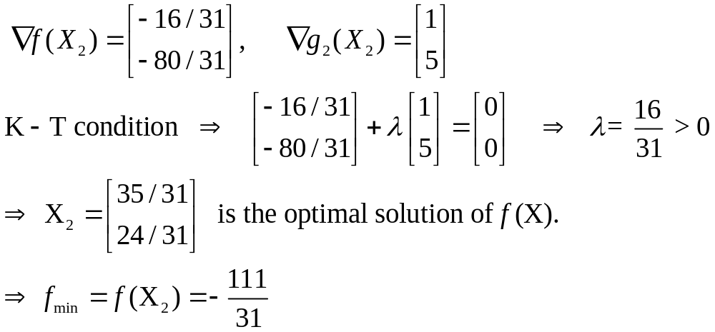
Solution to Ex. 6-1 (Cont’d)
(7) Convergence judgement:
at X₂ = [35/31, 24/31]^{T} :

